Slide 1
Image processing with Face Detection and Emotion Capturing Android App
Reflection

Slide 2
Objective
To make an android application that keeps track of human emotions over time using face recognition API.

Slide 3
Project Description
Now writing and keeping up with writing a diary may seem like a daunting task to do every day.
With our Android app, users will be impelled to track their emotions and daily endeavors because of its fun and effortless nature.
Every day at a time specified by the user, they are prompted to open our app and take a picture of their face.
Using Emotion and Face APIs, the emotional state of the user is determined and based on this emotion, a chat session is instigated in which the user is encouraged to express their feelings at the moment.
With this app, the user can keep track of emotional trends over time. The Statistics portion of the app displays the percentage of each emotion the user has had over the time.

Slide 4
Significance of the project
This app draws out the patterns of its user’s behaviors using AI and intelligently finds out its depressed users and suggests them ways to stay happy.
The users can integrate this app with their social networking accounts (facebook and whatsapp) to share their happiness trends.
Psychologists can use this app to accurately monitor user behavior over time and make better decisions.

Slide 5
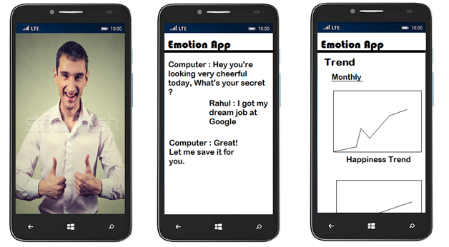
Wireframe Design

Slide 6

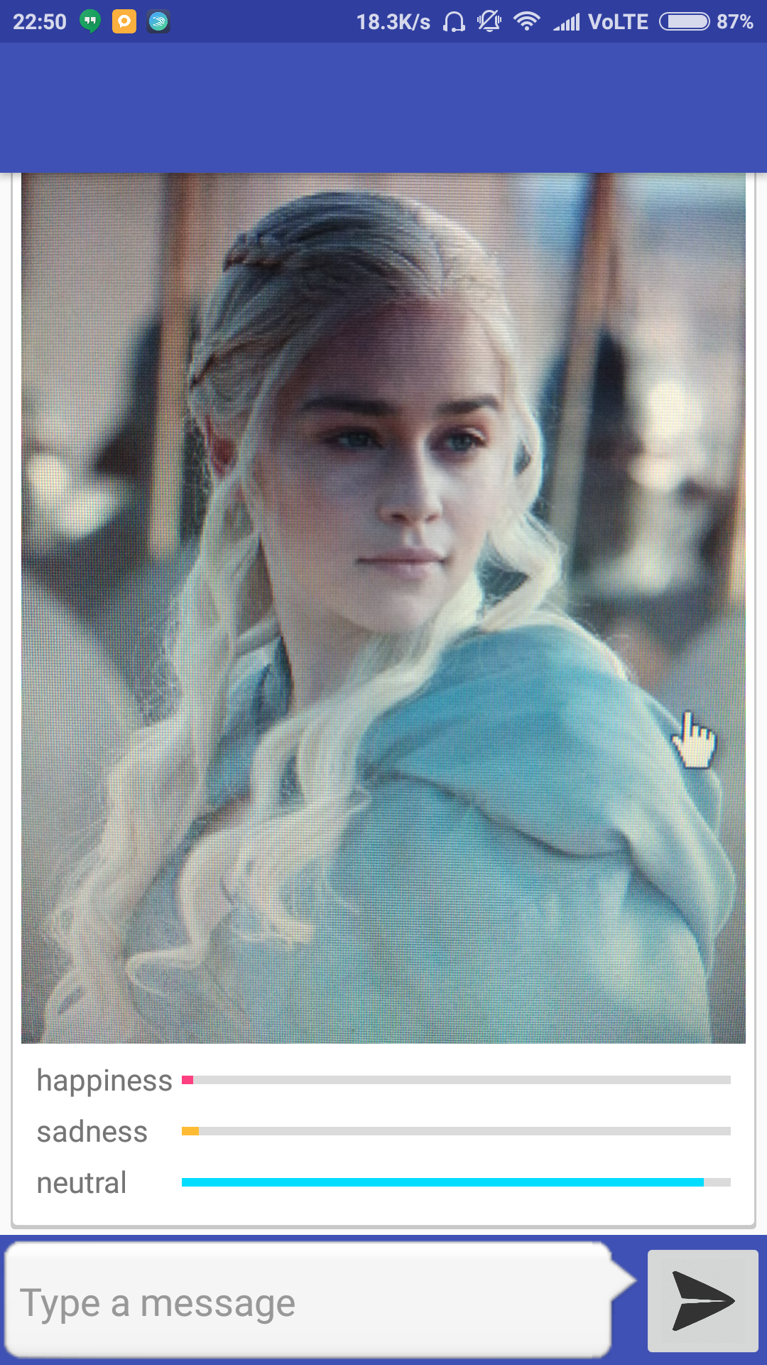
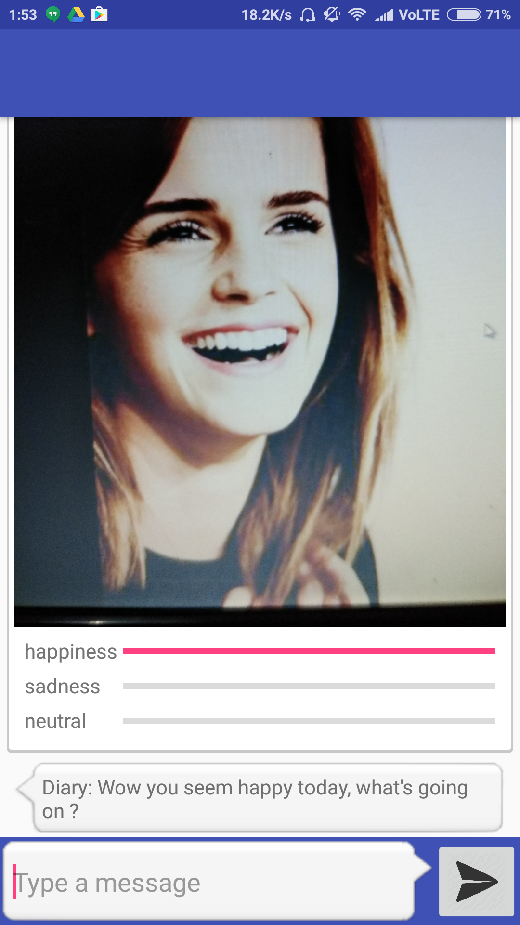
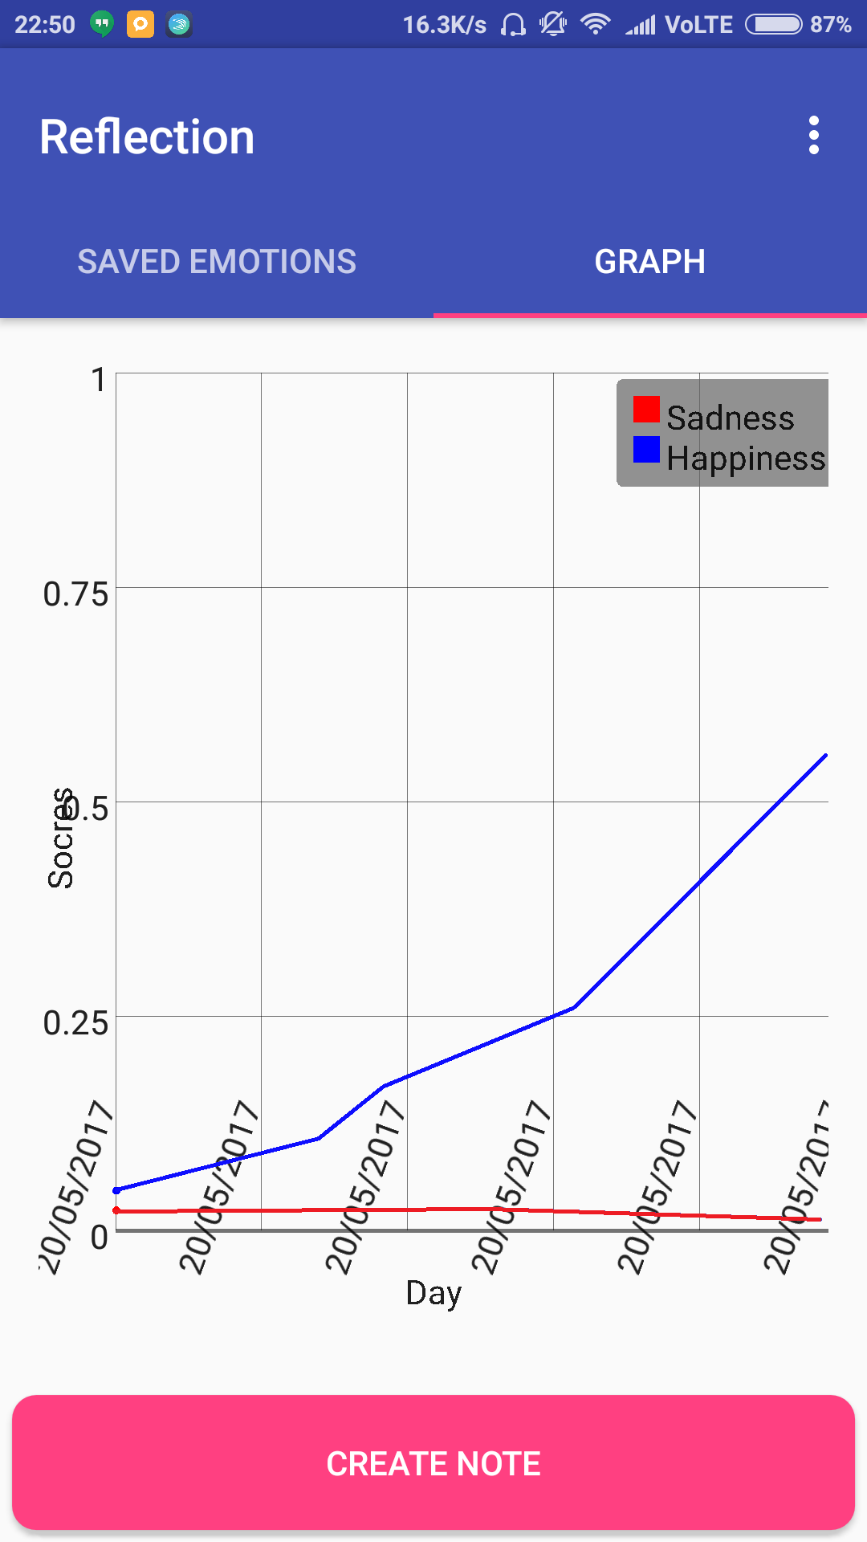
Screenshots

Slide 7

Screencast

Slide 8
Tools and technology used
Android Studio provides the tools for building apps on every type of Android device. It is a code editing, debugging, performance tooling, a flexible build system, and an instant build/deploy system all allow you to focus on building unique and high quality apps.
Microsoft Face API helps in detecting, analyzing, organizing and tagging faces in photos. This cloud-based API detects human faces in images using face rectangles and face attributes—including face landmarks, poses, and machine learning-based predictions of face attributes.
Microsoft Emotion API helps in creating apps that respond to moods, recognize feelings, and get personal with the Emotion API. Using facial expressions, this cloud-based API can detect happiness, neutrality, sadness, contempt, anger, disgust, fear, and surprise. The artificial intelligence algorithms detect these emotions based on universal facial expressions, functioning even cross-culturally.
Git Git is a distributed version control and source code management system. Version Control System (VCS) is a software that helps software developers to work together and maintain a complete history of their work. Git is Free and open source.

Slide 9
References
Android Studio: - https://developer.android.com/studio/index.html
Face API: - https://azure.microsoft.com/en-us/services/cognitive-services/face/
Computer Vision API: - https://azure.microsoft.com/en-us/services/cognitive-services/computer-vision/
Emotion API: - https://azure.microsoft.com/en-us/services/cognitive-services/emotion/
Clarifai: - https://developer.clarifai.com/
Git: - https://git-scm.com/

